Slide 1
A SEMINAR ON IoT-Driven Machine Learning for Precision Viticulture Optimization
UNDER THE GUIDANCE OF, By JOHNSON V MATHEW
MRS.NEENU SHEREEF S7 CG
ASsiSTANT PROFESSOR,CG Roll NO : 35

Slide 2
CONTENTS
Introduction
Related Works
System Requirements
Precision Agriculture
Problem Statement
Proposed System
Architectural Diagram
Evaluation Metrics
Frost Prediction
Soil Moisture Prediction
Disease Prediction
Future Work
Conclusion
References

Slide 3
INTRODUCTION
Precision viticulture (PV) applies digital technologies to vineyards, addressing spatial and temporal variability to standardize yields, enhance quality, and mitigate environmental impact.
IoT sensors collect high-resolution meteorological and soil data.
Machine learning (ML) models use these data for predictive decision support in frost mitigation, irrigation, and disease management.
Challenges: weather unpredictability, irrigation needs, disease outbreaks.

Slide 4
RELATED WORKS
ML for Frost & Disease Prediction: AI models like neural networks improve frost warnings for grapes and spot crop diseases (e.g., in wheat) using photos—with 95% accuracy.
Soil Moisture Prediction & Smart Irrigation: Hybrid ML algorithms predict soil moisture for optimized irrigation, reducing water use by 20-30% in smart systems integrated with IoT sensors.
IoT + ML + Remote Sensing: Widely used for wheat and maize in Morocco—e.g., satellite imagery for crop health, IoT sensors for soil/rain data, plus AI models predict yields with 99% accuracy via farmer apps.

Slide 5
SYSTEM REQUIREMENTS
Hardware:
MacBook Pro
Davis Vantage Pro2 weather station
Acclima TDR-315H soil moisture probes
Processor (CPU) | Intel Core i7, 2.6 GHz
Memory (RAM) | 2667 MHz DDR4
Graphics (GPU) | Intel UHD Graphics 630

Slide 6
SYSTEM REQUIREMENTS
Software:
Python 3.7.6
PyCharm IDE
Scikit-learn ML library
WeatherLink for sensor data management
ML algorithms used : Linear Regression, Random Forest, XGBoost

Slide 7
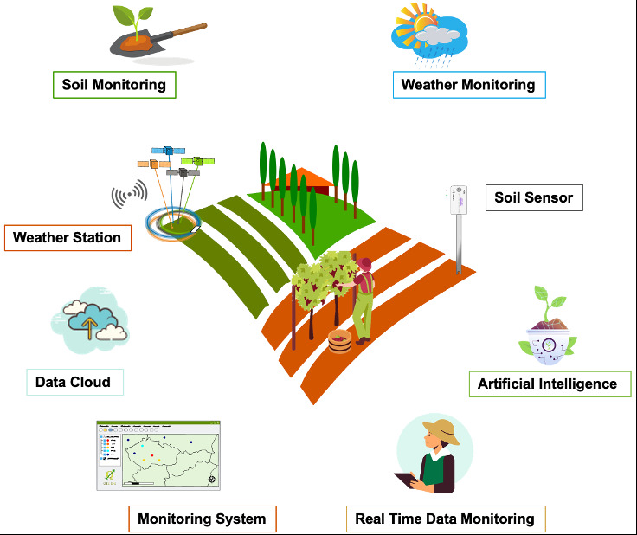
PRECISION AGRICULTURE
.

Slide 8
PROBLEM STATEMENT
Frost Damage Mitigation: Late-spring frosts can wipe out grape buds and shoots, costing vineyards millions better temperature forecasts help farmers act fast to protect crops and keep yields high.
Soil Moisture Optimization: Uneven soil moisture stresses vines and causes droughts, wasting water accurate predictions let farmers irrigate smartly for healthier plants and bigger harvests.
Grapevine Disease Management: Sudden diseases like mildew lead to over-spraying pesticides, hurting the environment early warnings allow targeted treatments to cut chemical use safely.

Slide 9
PROPOSED SYSTEM
Data Acquisition and Area
Location: Taurasi DOCG area, Montemiletto (Campania, Italy).
Time Span: 2021 to 2023 (approx. 2 years).
Frequency: 5 minutes.
Hardware:
Meteorological Data: Davis Vantage Pro2 Plus wired weather station (Air temp, humidity, dew point, wind, precipitation, solar radiation).
Soil Data: Three TDR probes (Acclima TDR-315H) at 30, 60, and 90 cm (Soil temp, soil moisture).

Slide 10
PROPOSED SYSTEM
Data Processing & Features
Objective | Model Type | Target | Key Input Features
Frost (D+1) | Regression | Min air temp next day (TMIN) | Daily mean temp (TAVG), solar radiation at 23:00 (RAD14), dew point humidity at 23:00 (DP23-H23), accumulated daily precip (RSUM).
Soil Moisture (D+1) | Regression | Overall daily avg soil moisture next day | Daily mean temp (TAVG), precip (RSUM), daily avg humidity (HAV G), overall daily avg soil temp/moisture (STAVGSMV).
Disease (D+1) | Binary Class | Downy mildew/Powdery mildew (1=infection, 0=otherwise) | Daily max temp (TMAX), max wind speed (WSMAX), max solar rad (SRMAX), max humidity (HMAX), cumulative daily precip (RSUM).

Slide 11
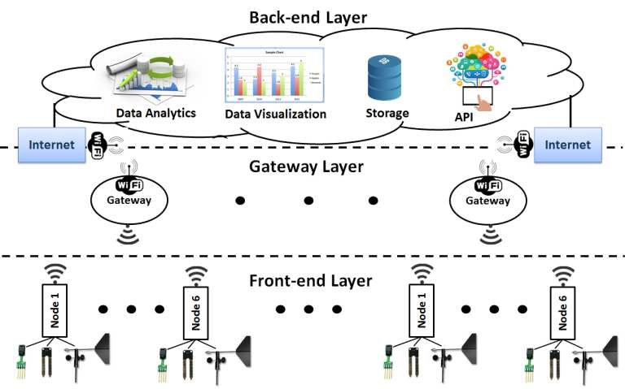
ARCHITECTURAL DIAGRAM

Slide 12
EXPERIMENTAL SETUP
Experiments conducted using free version of PyCharm IDE on MacBook Pro (2.6 GHz Intel Core i7 6-Core, 16 GB 2667 MHz DDR4 RAM, Intel UHD Graphics 630 with 1536 MB VRAM) with Python 3.7.6
Model training algorithms sourced from scikit-learn Python module, equipped with useful ML functions
Applied several well-known ML algorithms to address regression and binary classification tasks
Regression algorithms: Linear Regression (LR), Random Forest (RF) regressor, XGBoost (XGB), Support Vector Regression (SVR), Multilayer Perceptron (MLP) regressor
Binary classification models: Random Forest (RF), Support Vector Machine (SVM), XGBoost (XGB)
Employed grid-search tuning technique to identify most effective hyperparameters for models
Performed random dataset split for each database: 80% for training, 20% for testing
Statistics calculate: Min, Max, Mean.
Models trained/tested using 80/20 split.
Performance metrics: MAE, MSE, RMSE, R², F1, Precision, Recall.

Slide 13
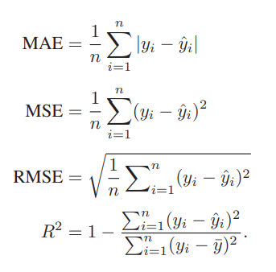
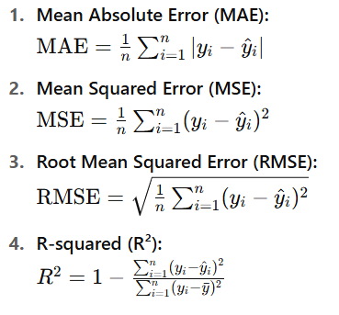
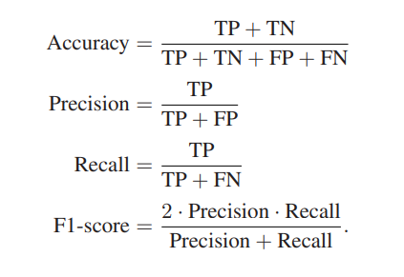
Evaluation Metrics
Vineyard Location: Montemiletto, Avellino, Italy.
Data period: 2021–2023, collected every 5 mins.
Meteorological: temperature, humidity, wind, dew point, solar radiation.
Soil: moisture at 30, 60, 90 cm depths using TDR probes.

Slide 14
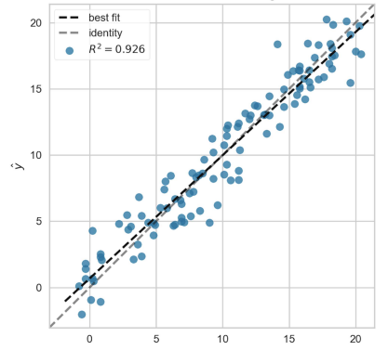
FROST PREDICTION
Goal: Predict next day’s minimum temperature.
Best Models: LR and RF
Results:
RMSE ≈ 1.6°C, R² ≈ 0.92
Accurate for frost prevention planning.

Slide 15
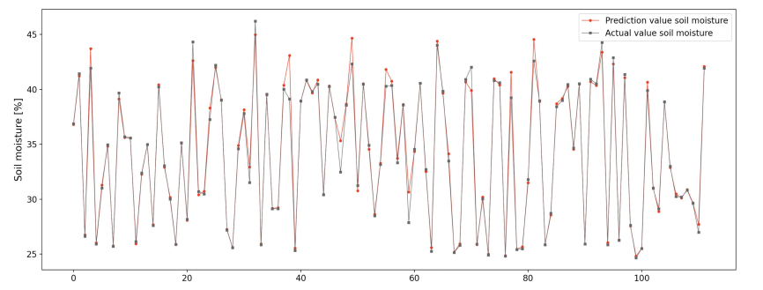
SOIL MOISTURE PREDICTION
Goal: Optimize irrigation using soil moisture forecasts.
Best Models: RF and LR
Results:
RMSE ≈ 0.8 ,R² ≈ 0.93
Helps reduce water
waste and energy
usage.

Slide 16
DISEASE PREDICTION
Goal: Spot disease risks early for quick action.
Focus on: Downy Mildew & Powdery Mildew
Best Models: XGB
Accuracy: Up to 97% (F1-score, Precision)
Farmers act early to stop disease spread.

Slide 17
FUTURE WORK
Use hourly data instead of daily → better real-time control
Integrate rainfall prediction for smarter irrigation
Include UAVs for aerial monitoring
Add deep learning for image-based disease diagnosis
Extend model to other crops and regions

Slide 18
CONCLUSION
IoT + ML offers smart, sustainable agriculture solutions
Accurate forecasting improves yields and reduces waste
Real-world testing in vineyards shows high success
Approach is scalable, cost-effective, and field-ready

Slide 19
REFERENCES
[1] C. Pero, S. Bakshi, M. Nappi, and G. Tortora, “IoT-Driven Machine Learning for Precision Viticulture Optimization,” IEEE Journal of Selected Topics in Applied Earth Observations and Remote Sensing, vol. 17, pp. 2437-2447, 2024, doi: 10.1109/JSTARS.2023.3345473
[2] J. Nie, Y. Wang, Y. Li, and X. Chao, “Sustainable computing in smart agriculture: Survey and challenges,” Turkish J. Agriculture Forestry, vol. 46, no. 4, pp. 550–566, 2022.
[3] L. Trivelli, A. Apicella, F. Chiarello, R. Rana, G. Fantoni, and A. Tarabella, “From precision agriculture to industry 4.0: Unveiling technological connections in the agrifood sector,” Brit. Food J., vol. 121, no. 8, pp. 1730–1743, 2019.
[4] N. Zhang, M. Wang, and N. Wang, “Precision agriculture—a worldwide overview,” Comput. Electron. Agriculture, vol. 36, no. 2/3, pp. 113–132, 2002.

Slide 20
THANK YOU.

